Slide 1
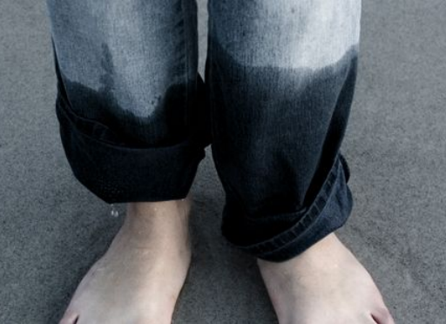
Problem 16 – Wet and Dark
reporter: Thiago Bergamaschi

Slide 2
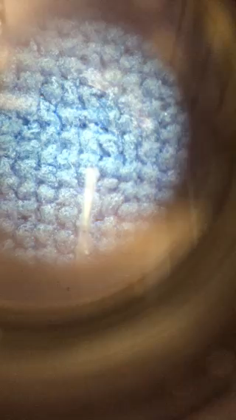
Problem 16 – Wet and Dark
Clothes can look darker or change colour when they get wet.
Investigate the phenomenon.
Optical Microscope View 40X

Slide 3
Theoretical Introduction
Experiments
Conclusion
Qualitative Analysis
Materials
Data Analysis
Relevant Parameters
Procedures
Quantitative Analysis
Prediction of Relevant Parameters
Notes:
Here are the contents of my presentation. I will start with a theoretical introduction, after that I will speak about our experiments and finally I will give the conclusion.

Slide 4
Qualitative Analysis: Surface Reflection

Slide 5
Qualitative Analysis: Surface Reflection

Slide 6
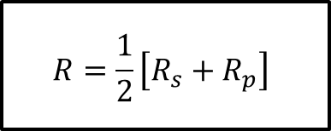
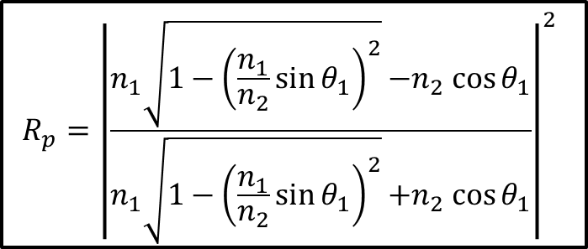
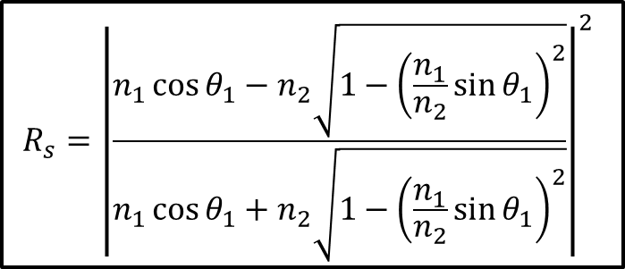
Quantitative Analysis: Fresnels Equations
Perpendicular Polarization
$$R_{s}={\left|\frac{n_{1}\cos{θ_{1}−n_{2}\sqrt{1−{\left(\frac{n_{1}}{n_{2}}\sin{θ_{1}}\right)}^{2}}}}{n_{1}\cos{θ_{1}+n_{2}\sqrt{1−{\left(\frac{n_{1}}{n_{2}}\sin{θ_{1}}\right)}^{2}}}}\right|}^{2}$$
θ₁
θ₁
n₁
n₂
θ₂
$$R_{p}={\left|\frac{n_{1}\sqrt{1−{\left(\frac{n_{1}}{n_{2}}\sin{θ_{1}}\right)}^{2}}{−n}_{2}\cos{θ_{1}}}{n_{1}\sqrt{1−{\left(\frac{n_{1}}{n_{2}}\sin{θ_{1}}\right)}^{2}}{+n}_{2}\cos{θ_{1}}}\right|}^{2}$$
Nonpolarized Light
Total Reflectance
$$R=\frac{1}{2}\left[R_{s}+R_{p}\right]$$
Parallel Polarization

Slide 7
Qualitative Analysis: Material Reflection
Incident Medium´s Refraction Index
Reflectance [%]
Origin Medium´s Refraction Index

Slide 8
Qualitative Analysis: Material Reflection
Dry Cloth
Wet Cloth

Slide 9
QuantitativeAnalysis: Surface Reflection
Lambert’s Reflection Law
1- R_{l}(1-a)
1- R_{l}(1-a)p
1- R_{l}

Slide 10
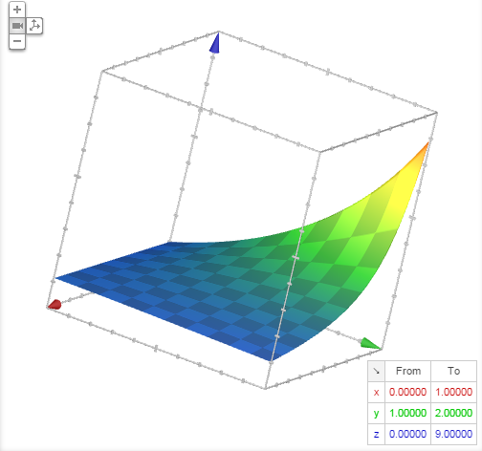
Qualitative Analysis: Surface ABSORtion

Slide 11
Prediction of Relevant Parameters
Liquid Volume
Maximizing Liquid Cloth Reflections,
instead of Cloth air
Liquid Refraction Index close to Cloth´s
Minimizing Reflection
by Fresnels law
Thread Density
Increases thread reflections
Cloth Thickness
Maximizes Reflection
Cloth Dry Absortion
Minimizes “darkening” effect

Slide 12
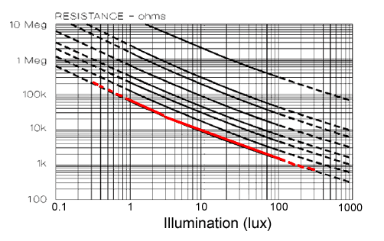
Light-Dependent Resistor
1000
100
10
1
0.1
Illumination (lux)
0
Cadmium
sulphide
track
+
-
100 1k 10k 100k 1M 10M
Resistance (Ω)

Slide 13
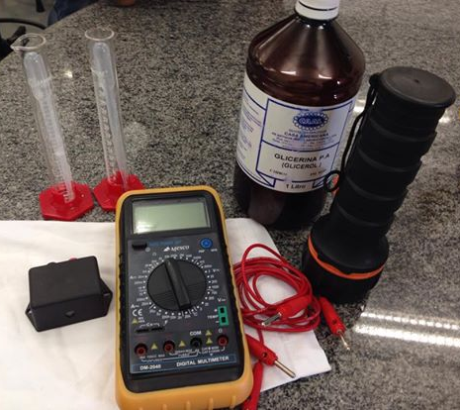
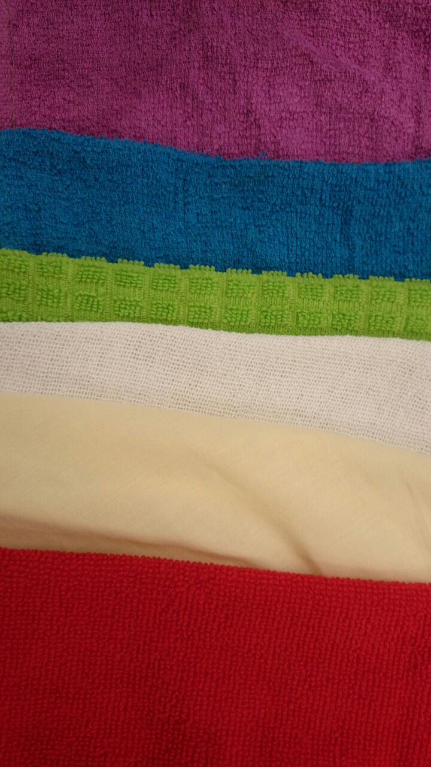
Materials
Varied Cloths
Multimeter (Δx=±0.01kΩ)
Light Dependent Resistor
Lantern
Measuring Cylinder (Δx= ±0.1mL)
Pipette (Δx=±0.1mL)
Water
Glicerin

Slide 14
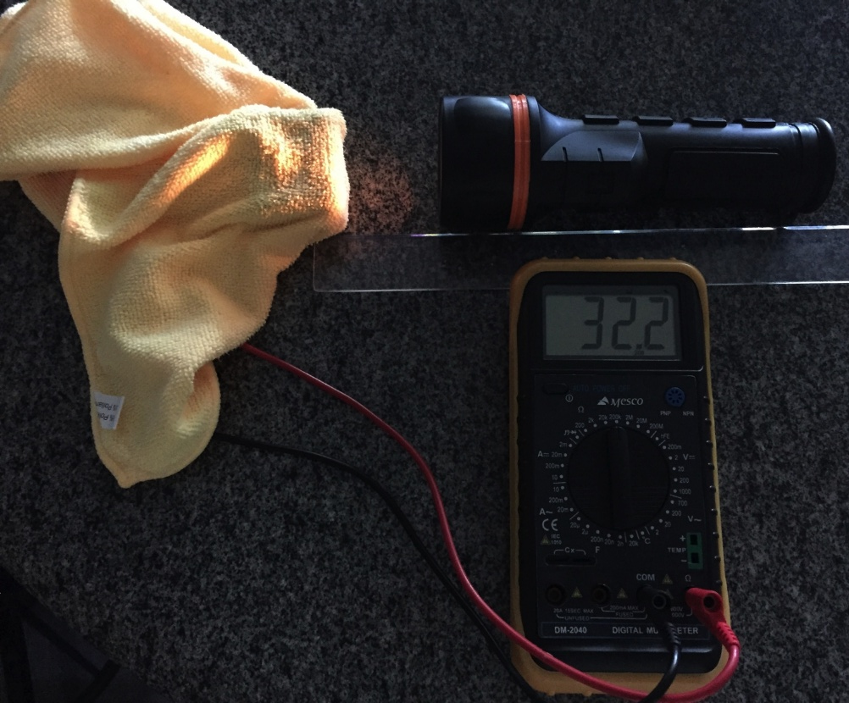
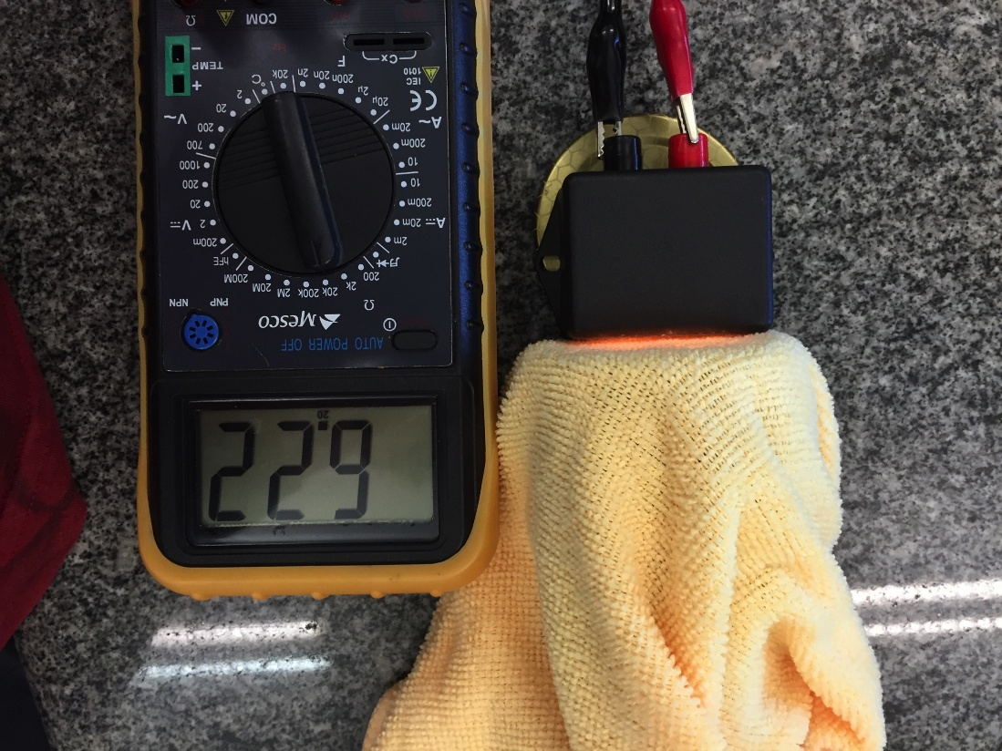
Procedures
Connect the Multimeter with the LDR
In a isolated room (without secondary light sources), measure the emerging light intensity
Vary the Water Volume in the Cloth (0.0, 1.0, 2.5, 5.0, 7.5, 10.0), as well as color, liquid and cloth thickness

Slide 15
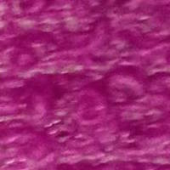
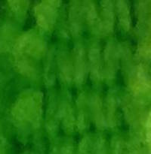
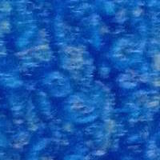
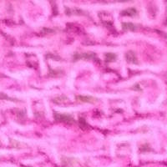
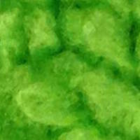
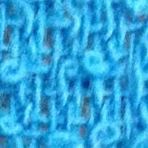
Experiment 2
Take photos of a standardized area, dry and with a (10.0 ± 0.1) mL water volume.
Plot the corresponding histograms and compare the photos.

Slide 16
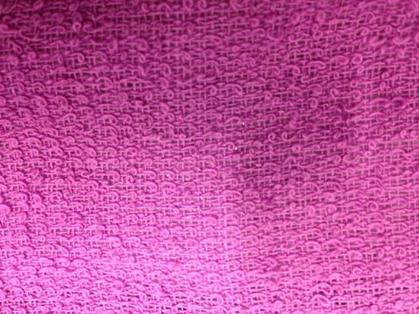
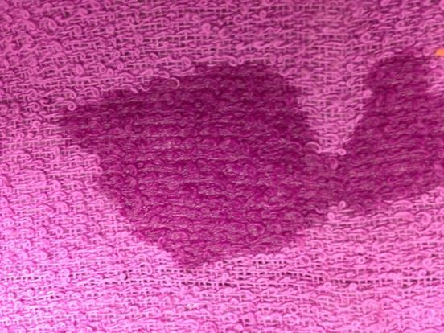
Photos

Slide 17
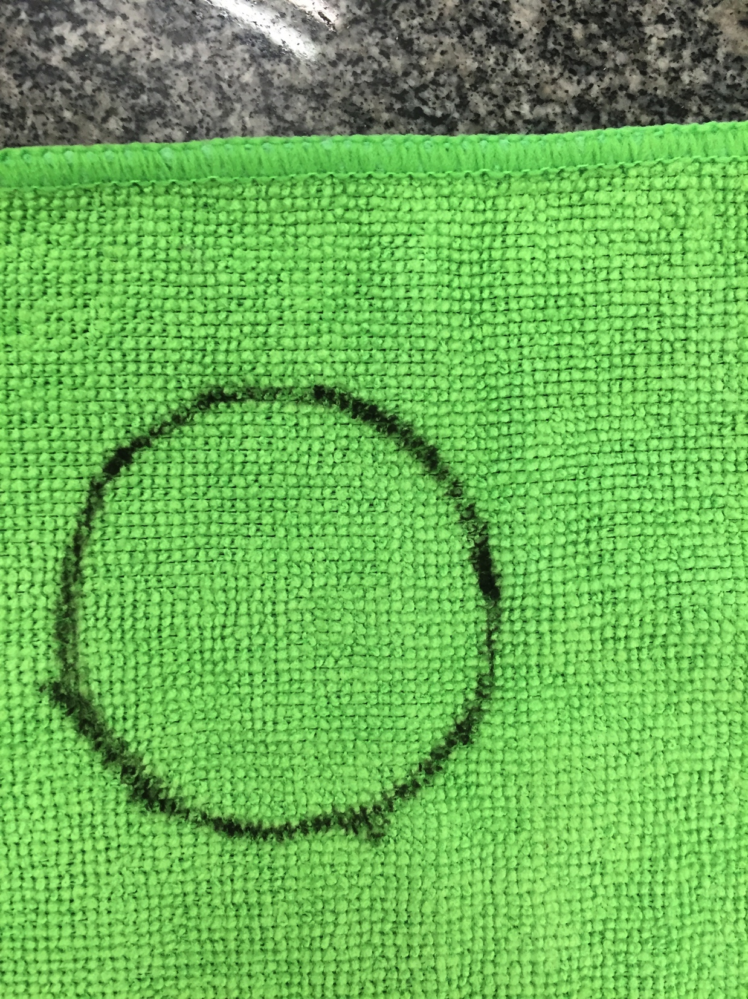
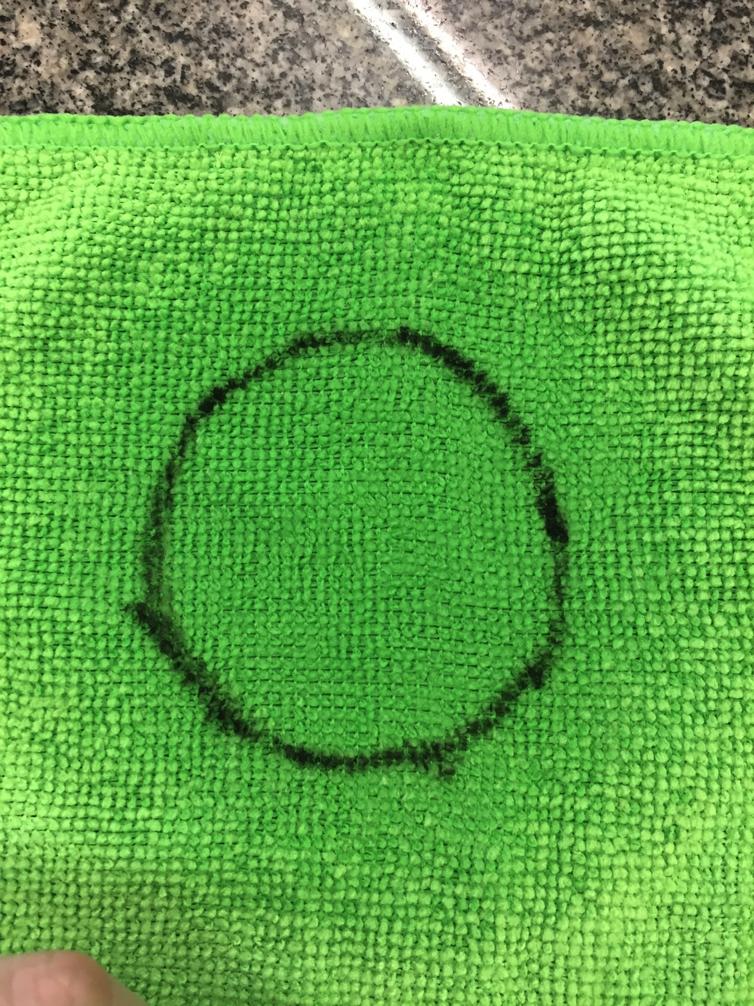
Photos

Slide 18
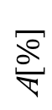
Data Analysis
Original Color
High Dry Absortion
Cloth Thickness
Refraction Index
Minimizing the Phenomenon
Cloth Material
Cloth Permeability
LDR Distance
White Yellow Green Red Blue Purple
Histograms
Original Color

Slide 19
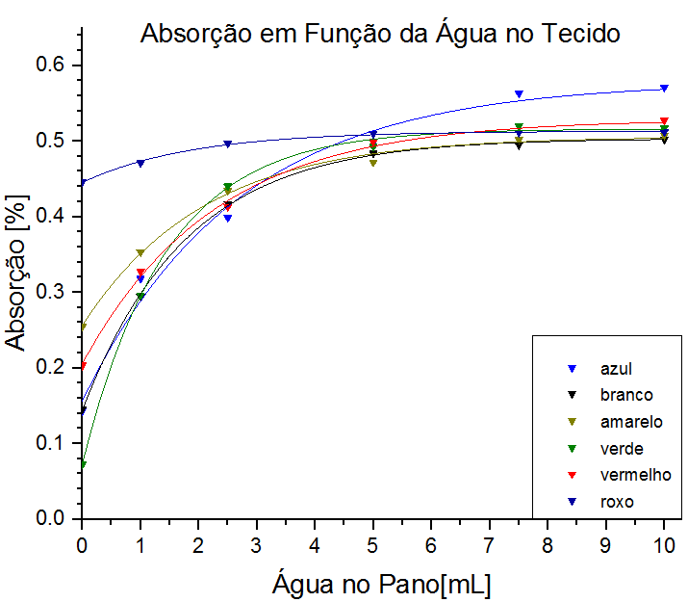
Data Analysis
Original Color
Applied Water Volume Variation
Higher the Water Volume
Cloth Thickness
Refraction Index
Cloth Material
Transmitance [%]
Higher the Transmitance
Cloth Permeability
Blue
White
Yellow
Green
Red
Purple
LDR Distance
Maximizing the Phenomenon
Histograms
Liquid Volume [mL]

Slide 20
Data Analysis
Original Color
Thicker the Cloth
Cloth Thickness
Refraction Index
Higher the Material Reflection
Cloth Material
Cloth Permeability
Minimizing the Phenomenon
LDR Distance
Histograms

Slide 21
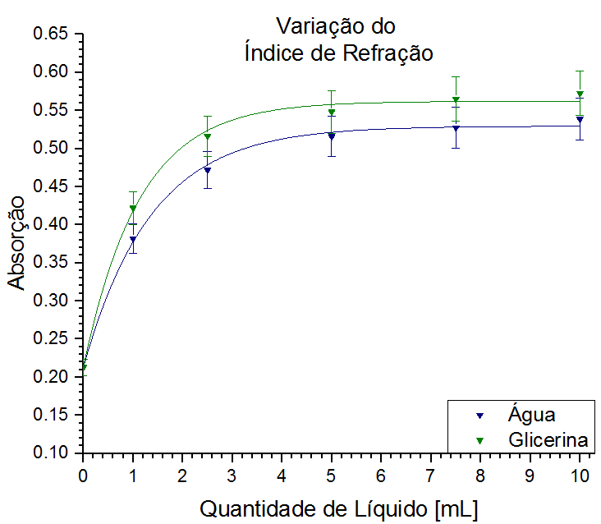
Data Analysis
Original Color
Refraction Index Comparison
Refraction Index Comparison
Closer the Liquid´s Refraction Index to the cloth´s
Cloth Thickness
Refraction Index
Cloth Material
Transmitance [%]
Refraction Index
Water: 1.332
Glicerin: 1.473
Lower the Material Reflection
Absorbtion [%]
Cloth Permeability
LDR Distance
Maximizing the Phenomenon
Water
Glicerin
Histograms
Liquid Volume [mL]
Liquid Volume [mL]

Slide 22
Data Analysis
Original Color
Cloth Thickness
Higher Liquid Temperature
Refraction Index
Cloth Material
Lower the Refraction Index
Cloth Permeability
LDR Distance
Minimizing the Phenomenon
Histograms

Slide 23
Data Analysis
Original Color
Cloth Thickness
Refraction Index
Dry Absortion
Cloth Material
Refraction Index closer to water´s
Cloth Permeability
LDR Distance
Histograms

Slide 24
Data Analysis
Original Color
Cloth Thickness
Refraction Index
Little Variation
Cloth Material
Cloth Permeability
LDR Distance
Histograms

Slide 25
Data Analysis
Data Analysis
Original Color
Impermeability
Cloth Thickness
Refraction Index
Maximizing Air-Cloth Material Reflection
Cloth Material
Cloth Permeability
Minimizing the Phenomenon
LDR Distance
Histograms

Slide 26
Data Analysis
Original Color
Falls off Quadraticly
Cloth Thickness
Refraction Index
Lower Light Intensity Transmitted and Reflected
Cloth Material
Cloth Permeability
LDR Distance
Histograms

Slide 27
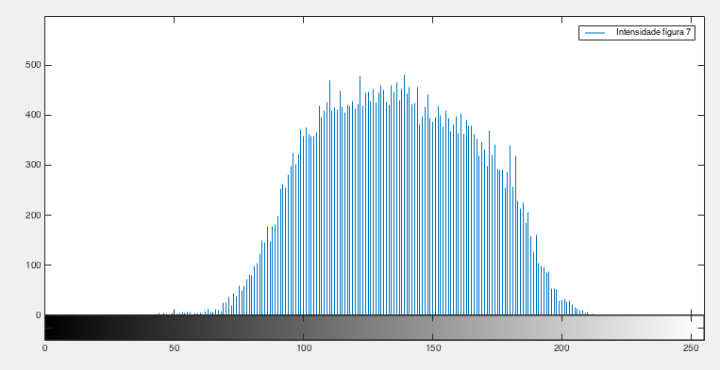
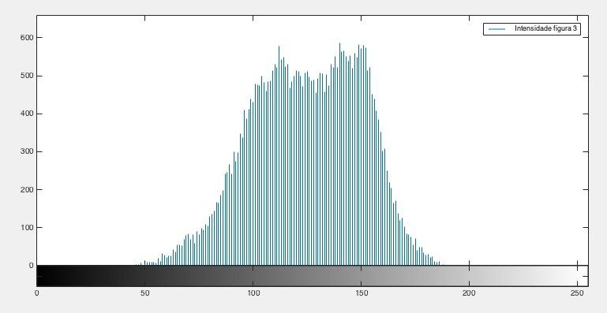
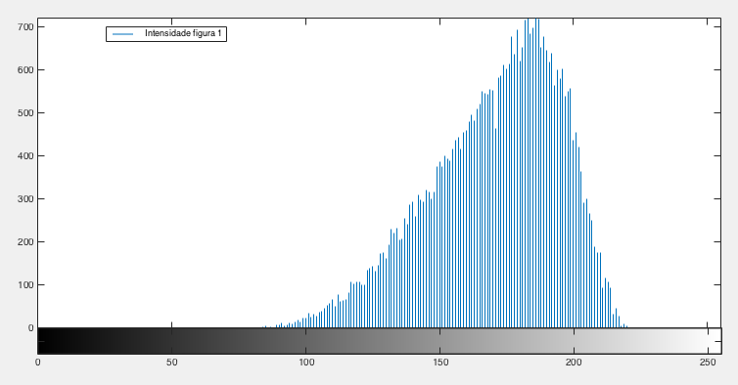
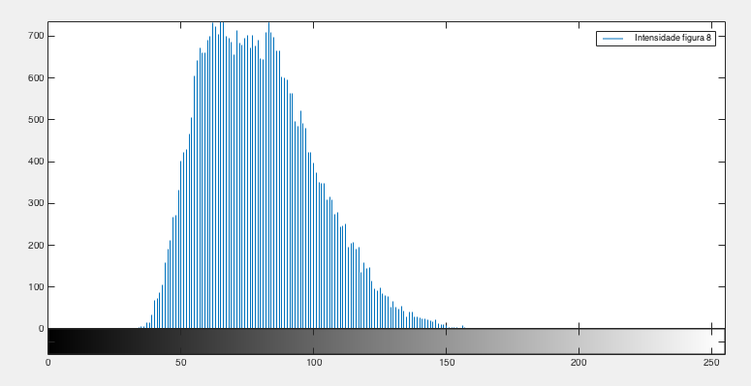
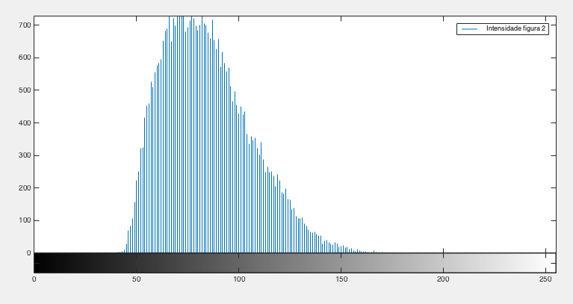
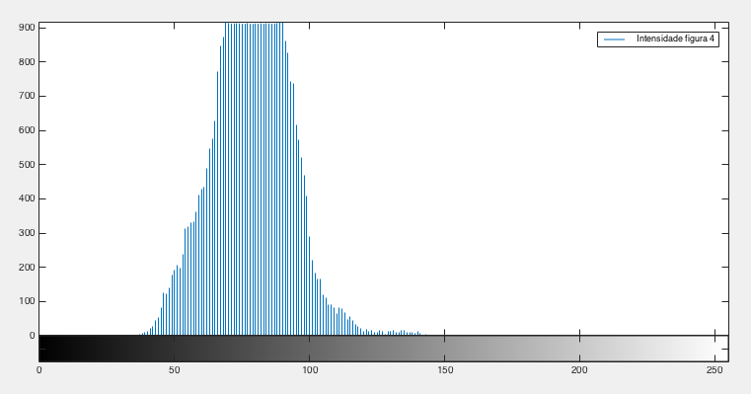
Data Analysis
Original Color
Cloth Thickness
Refraction Index
Cloth Material
Cloth Permeability
LDR Distance
Histograms

Slide 28
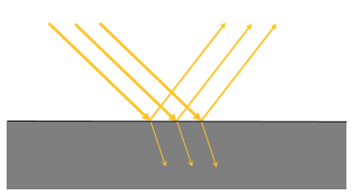
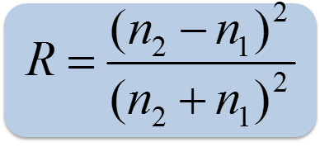
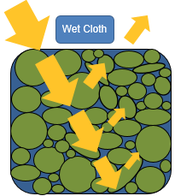
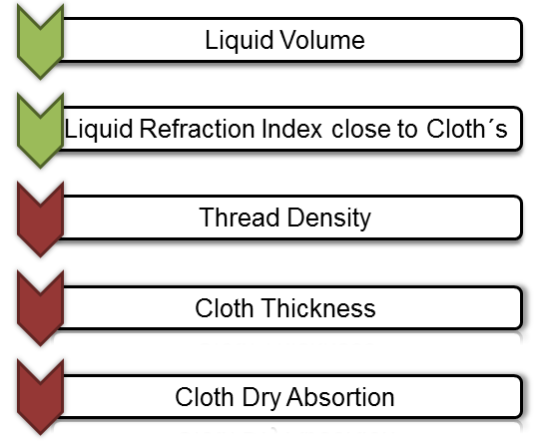
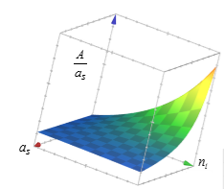
Summary: Theoretical Introduction

Slide 29
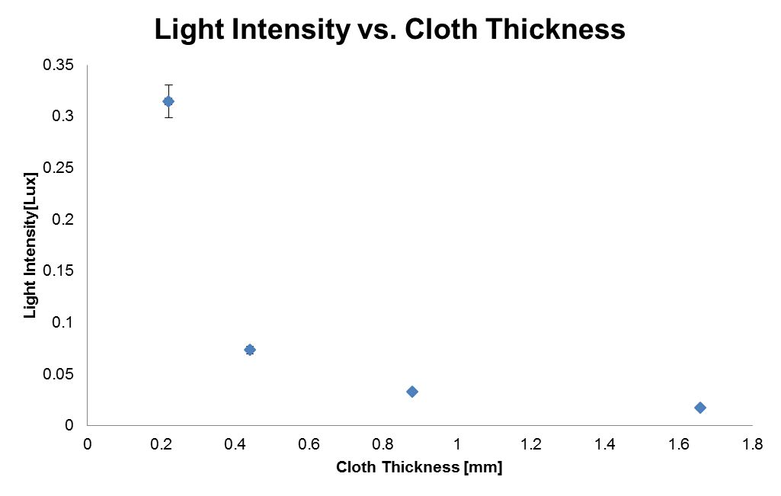
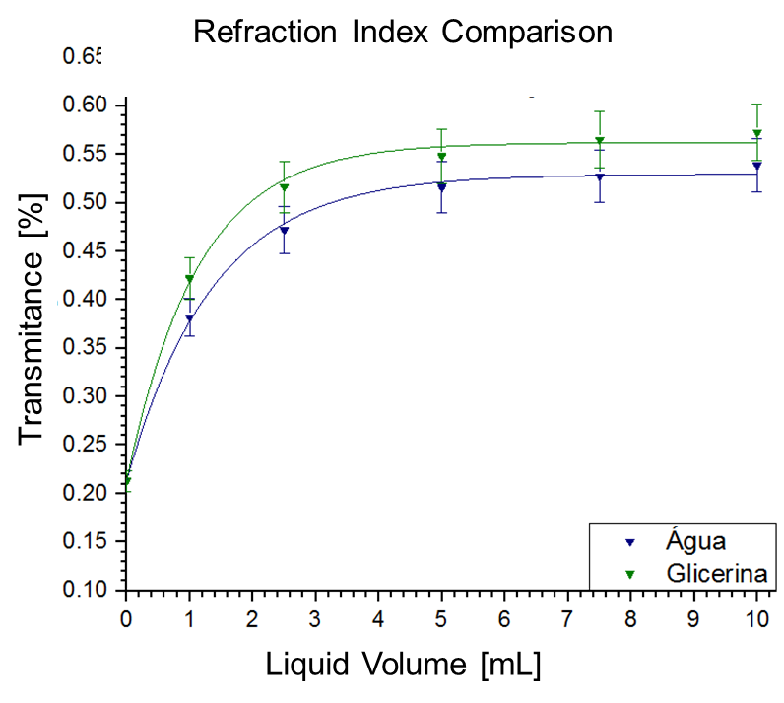
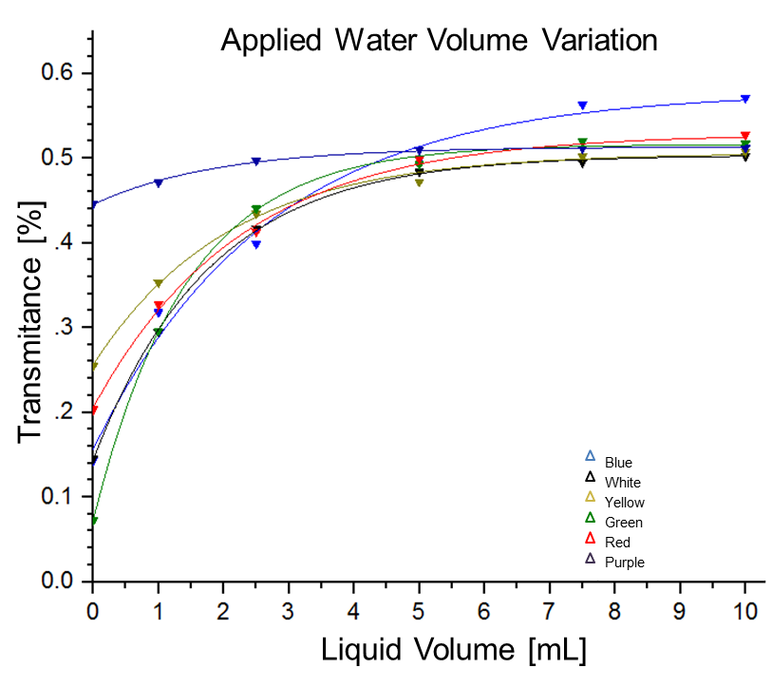
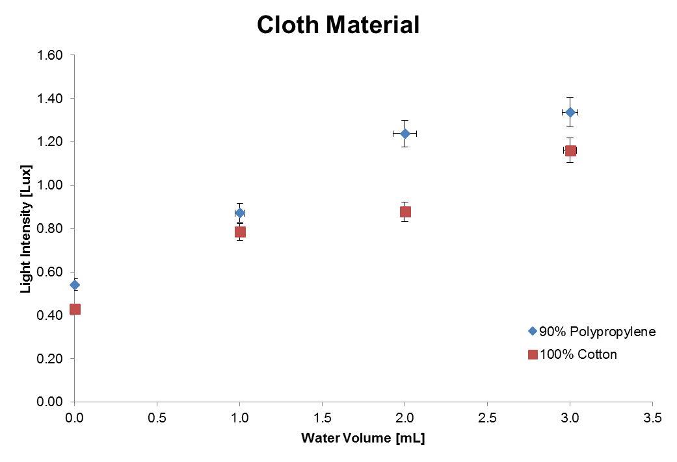
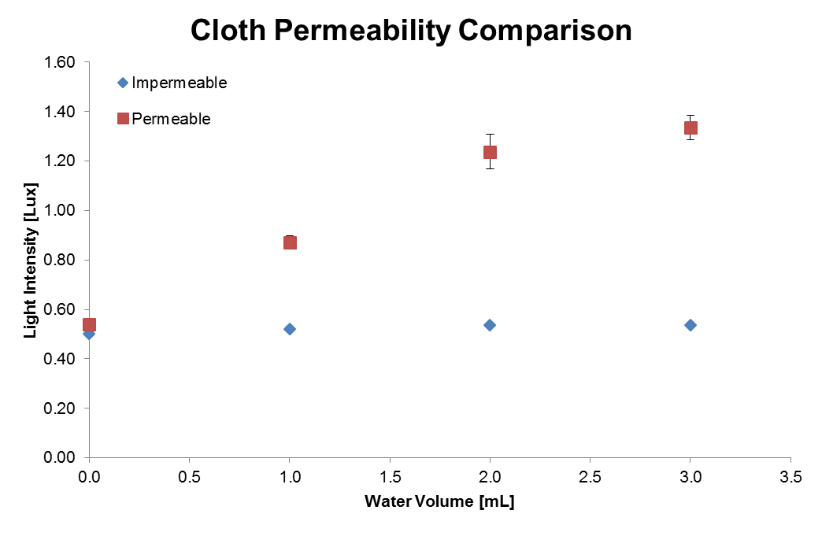
Summary: Experiments

Slide 30
Conclusion
Liquid Volume
The Bigger, the Better
Liquid Refraction Index close to Cloth´s
Thread Density
Cloth Thickness
The Smaller, the Better
Cloth Dry Absortion

Slide 31
Bibliografy
Link http://pt.wikipedia.org/wiki/Refra%C3%A7%C3%A3o
Linkhttp://axpfep1.if.usp.br/~otavianoporquecoisasmolhadasficammaisescuras.html
Link http://pt.wikipedia.org/wiki/Espectro_vis%C3%Advel
Lekner, John. Dorf, Michael C. Why some things are darker when wet., APPLIED OPTICS, Vol.23, No7, 1988.
Link http://www.mspc.eng.br/elemag/opt0210.shtml
Link https://en.wikipedia.org/wiki/Fresnel_equations

Slide 33
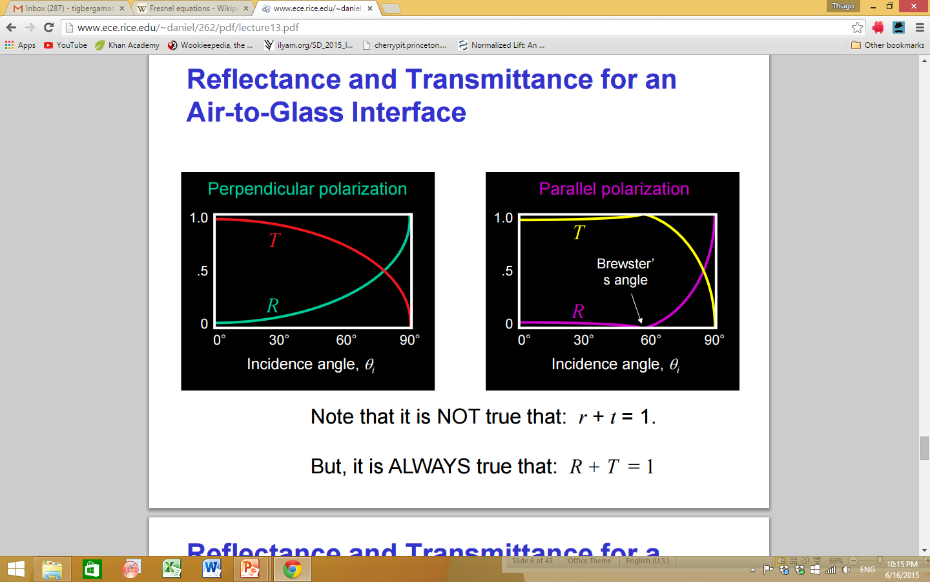
Appendix 1: S Polarized Light
Polarized, Thus Lower Light Intensity
Darker, though less intense
The more Inclined, higher Reflectance
Minimizing the Phenomenon
http://www.ece.rice.edu/~daniel/262/pdf/lecture13.pdf

Slide 34
Appendix 2: P Polarized Light
Polarized, Thus Lower Light Intensity
Darker, though less intense
R follows a peculiar format
Where R is minimized, T is Maximized
http://www.ece.rice.edu/~daniel/262/pdf/lecture13.pdf

Slide 35
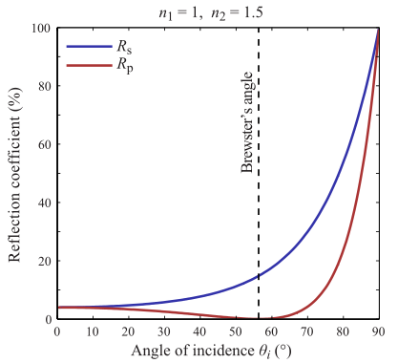
Appendix 3: Incidence Angle
Incident Angle Increase
Higher Reflectance
Minimizing the Phenomenon
https://en.wikipedia.org/wiki/Fresnel_equations

Slide 36
Appendix 4: Light Source Comparison
Higher Focalizing power

Slide 37
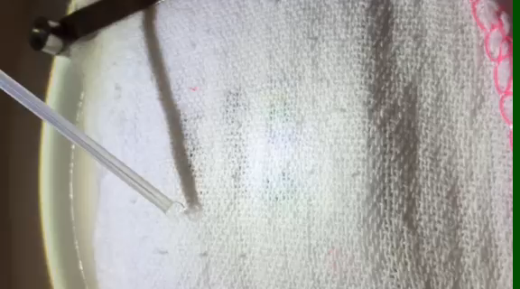
Appendix 5: Wet, Transparent, White Cloths
Coisas molhadas são, usualmente, mais escuras, quando as observamos sob iluminação, pois a luz penetra mais facilmente do que quando secas. Areia, papel, cimento, terra, etc, têm essa propriedade.
Mas, se a luz penetra mais profundamente em coisas molhadas, então elas podem ser mais transparentes ou translúcidas do que quando secas? Sim. Pegue um pedaço de papel de cozinha (ou guardanapo de papel, ou papel de enxugar a mão) e, observando contra uma fonte de luz, note que, se molhado, mais luz o atravessa.
O mesmo ocorre com tecidos: se molhados, ficam mais escuros quando são observados sob a luz ... mas ficam também mais transparentes, o que, constrangedoramente, ocorre quando se mergulha na água com um tecido inadequado
Higher Transmitance
Darker and Transparent
Lower Reflectance

Slide 38
Appendix 5: Brewster´s Angle

